Slide 1
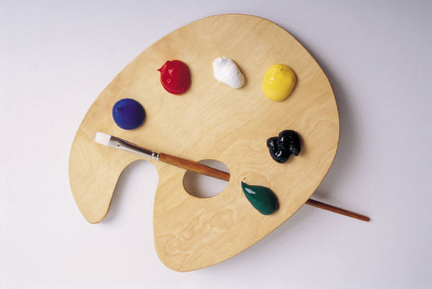
ARTICLES
ČLANOVI

Slide 2
U engleskom jeziku razlikujemo određene i neodređene članove.
THE
A / AN

Slide 3
Neodređeni član A / AN
Neodređeni član an pišemo ispred imenica koje započinju samoglasnikom (a, e, i, o, u):
AN APPLE AN ORANGE AN ELEPHANT
PAZI!
Važno je i kako izgovaramo neku riječ:
AN HOUR
A UNIQUE WATCH, A UNIVERSITY ,
A EUROPEAN PROJECT

Slide 4
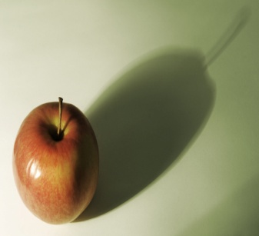
A / AN
Naziv dolazi od one (1) i ne može biti ispred imenica u množini:
an apple (1 jabuka)
an apples

Slide 5
Neodređeni član NE upotrebljavamo:
Ispred imenica u množini:
birds, children, people, windows
Ispred nebrojivih imenica (uncountables):
meat, music, snow, oil, love, information, water...
an information, informations
Ali: a piece of information, a glass of water,

Slide 6
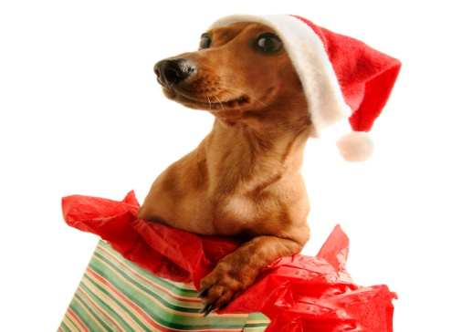
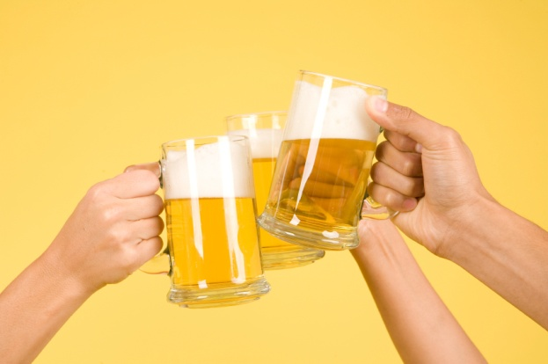
Neodređeni član (a / an) koristimo:
1) Ispred imenica koje spominjemo po prvi puta u razgovoru
I see a dog.
An Englishman, an Irishman, a Scotsman and a Welshman went into a pub.

Slide 7
2) Ispred pridjeva kada opisujemo nešto ili nekoga:
A brown dog, a big tree, an interesting story, a beautiful dress, a high mountain, a loud crowd,
My friend has got a nice smile, a big nose and long hair.
I’ve got a big round kitchen table.

Slide 8

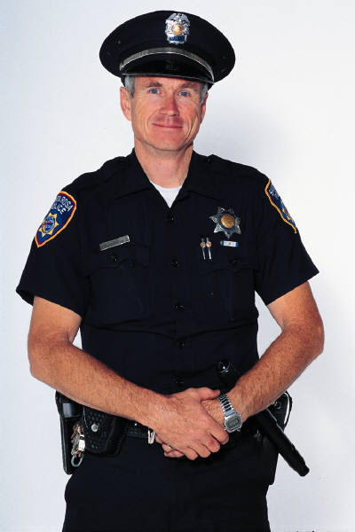



3) Ispred naziva za poslove:
AN architect
A policeman
A postman
A hairdresser
A cook
A teacher
A painter
A secretary

Slide 9
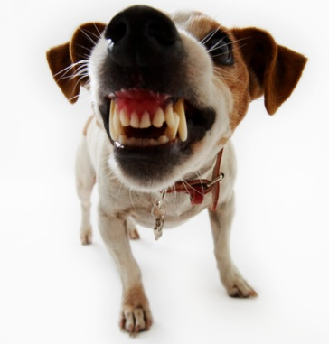
4) poslije There is ..../ Is there / There was / Was there...
Is there a hotel nearby?
Yes, there is. / No, there isn’t.
There is a hotel round the corner.
There is a big unleashed dangerously-looking dog in the street.
There was a big dog in the street.

Slide 10
ODREĐENI ČLAN
Određeni član je THE
Dolazi od this i that

Slide 11

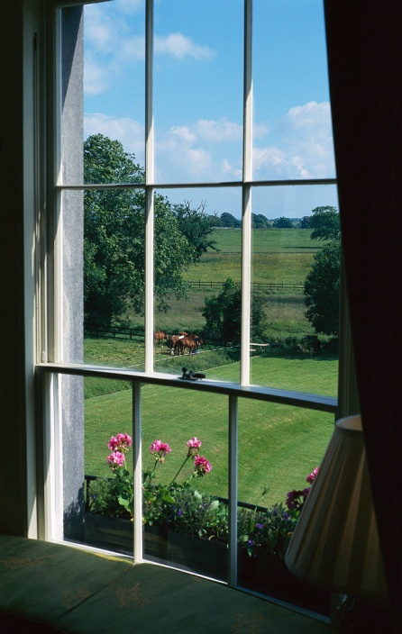
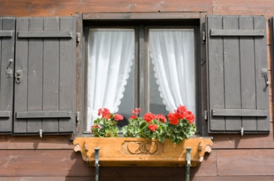
Open a window.
(bilo koji prozor u sobi)
Open the window.
(upravo TAJ / OVAJ / JEDINI PROZOR u sobi!)

Slide 12

Određeni član koristimo:
Kada nam je već nešto poznato, odnosno spomenuto u razgovoru i znamo TOČNO na što se misli.
I see a brown dog. The dog looks very sad.
I saw a film on TV. I didn’t like the film.
In the pub the Englishman, the Irishman, the Scotsman and the Welshman drank a lot of beer.

Slide 13
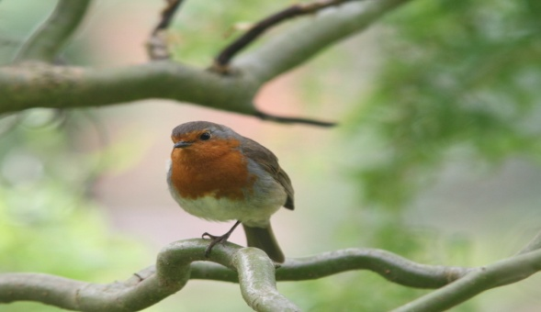
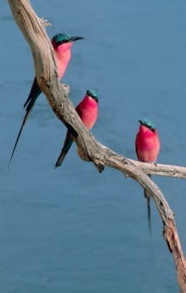
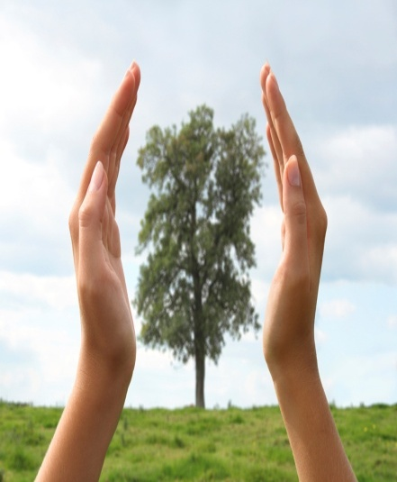
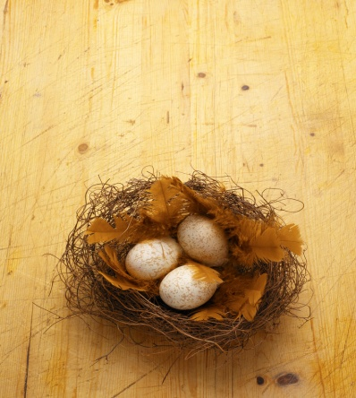
Primjer:
There is A mountain far away.
And on THE mountain stands A tree.
And on THE tree there is A branch.
And on THE branch there is A nest.
And in THE nest there is AN egg.
And in THE egg there is A bird.
One day THE bird will fly.
One day we will be free.
(old folk song)

Slide 14




2) Ispred imenica koje su jedinstvene (jedine) u određenom kontekstu
the Sun (veliko slovo ako se misli na sunce kao središte našeg planetarnog sustava) ; the Earth, the Moon, ...
the President, the Prime Minister, the Queen, the Pope,
The headmaster / the headmistress, the boss
3) S instrumentima:
the piano, the guitar, the horn, the drums, ...

Slide 15
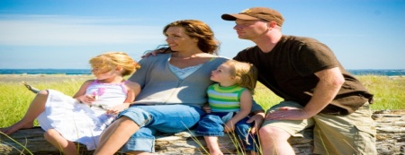
5) Ispred rednih brojeva:
the first, the second, the twenty-second, the thirty-fifth, the fiftieth birthday...
6) Ispred pridjeva u superlativu:
the biggest, the highest, the most famous, the best, the worst, the most dangerous...
7) Ispred prezimena (kada mislimo na CIJELU obitelj): the Simpsons, the Smiths, the Horvats

Slide 16
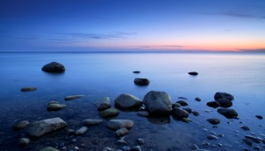

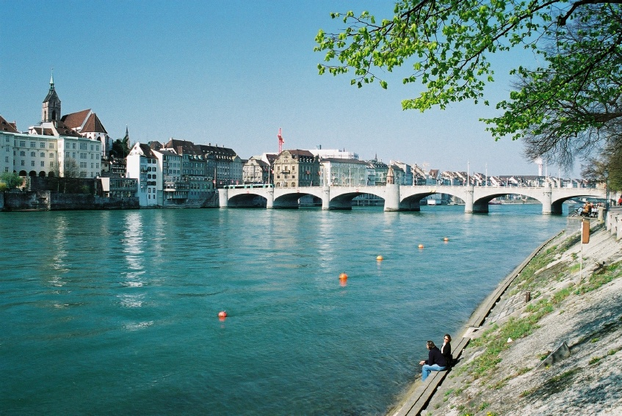

Određeni član + nazivi
Pustinja, planinskih lanaca, rijeka, mora i oceana (ali ne i jezera!):
the Sahara Desert, the Alps, the River Drava,
the Adriatic Sea, the Mediterranean,
the Atlantic
Nazivi zemalja koji su u množini:
the Netherlands, the USA, the EU,

Slide 17


Nazivi zemalja koji u sebi sadrže imenicu REPUBLIKA, KRALJEVSTVO, itd.
Imaju OF u nazivu
THE CZECH REPUBLIC
THE UNITED KINGDOM
THE PEOPLE’S REPUBLIC OF CHINA
THE REPUBLIC OF IRELAND
THE REPUBLIC OF CROATIA
Ali:
CROATIA

Slide 18
Kada se misli na DIO svijeta također koristimo određeni član (i veliko početno slovo), npr.:
the West, the Middle East, the Far East
The + nazivi kazališta, kina,
The Cinestar
The Croatian National Theatre

Slide 19
ČLANOVE najčešće izostavljamo:
Ispred apstraktnih imenica: love, happines, beauty...:
Beauty doesn’t last forever.
Ispred vlastitih imena, imena država, gradova i kontinenata:
Zagreb is the capital of Croatia. ; Europe, Asia, North America
Ispred imena ULICA, TRGOVA, PARKOVA, MOSTOVA..
Central Park is in New York. This is Varaždinska Street.
Jelačić Square is in Zagreb.
Kada posvojna zamjenica stoji ispred imenice:
my book, my blue dress, his big round table...

Slide 20
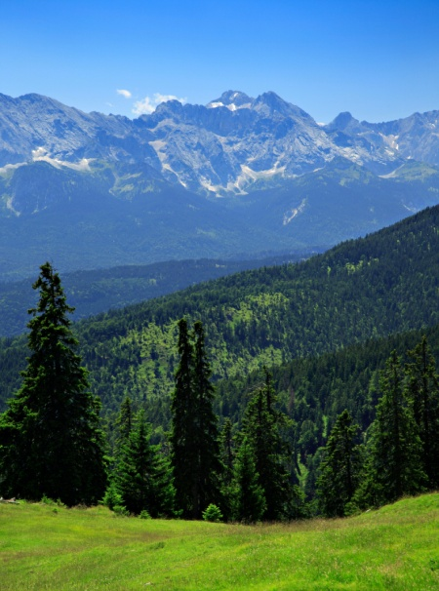
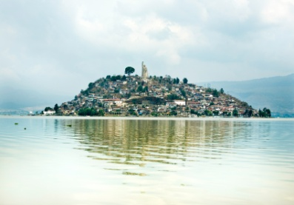
Ispred naziva jezera, otoka i planina u JEDNINI NEMA člana:
Vrana Lake is near Biograd.
Hvar is the sunniest Croatian island.
ALI:
THE ALPS, THE HIMALAYAS, THE PLITVICE LAKES, THE BAHAMAS (nazivi u MNOŽINI!)
The Island of Hvar, the Island of Lastovo.... (of!)

Slide 21
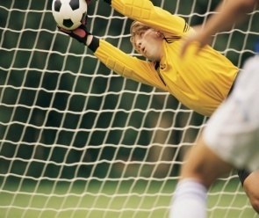
Ispred jezika, školskih predmeta, sportova, igara NEMA člana:
Can you speak Russian?
He loves football and tennis.
History and geography are my favourite school subjects.
Ispred dana u tjednu i naziva mjeseci također nema člana:
See you on Monday!

Slide 22
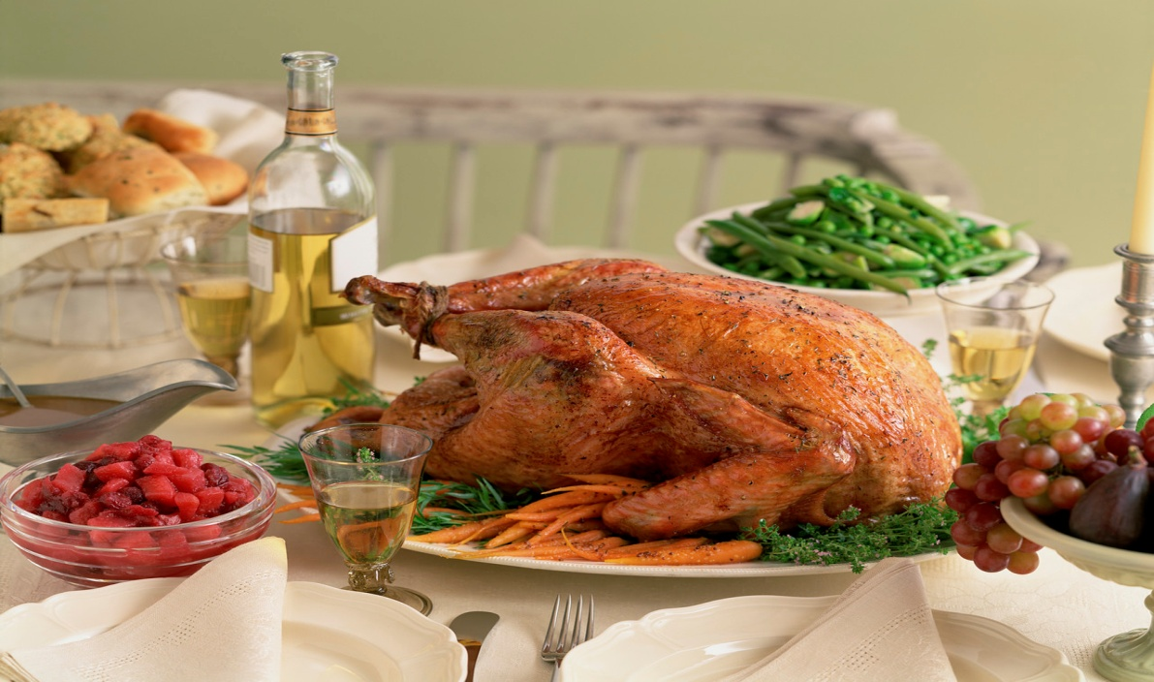
NEMA ČLANA ispred naziva za obroke!
Let’s have lunch together!
What time is dinner?

Slide 23

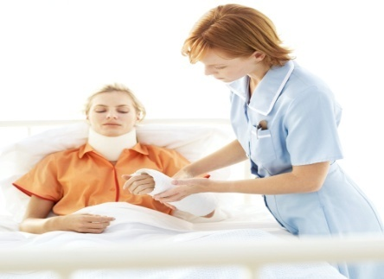
FIKSNI IZRAZI U KOJIMA NEMA ČLANOVA:
Go to school / go to church / go to work / go home
Go to prison / I am in prison (as a prisoner).
Go to hospital / I am in hospital (as a patient).
Ali:
I’m going to the hospital /to the prison to visit my boyfriend. (kao posjetitelj!!)

Slide 24
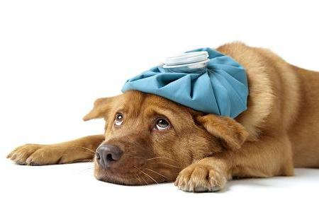

Slide 25
Upotrijebi: A/AN, THE ili ostavi prazno
My sister lives in _____big flat.
Where’s ____phone? In ____kitchen.
Most people are _____funny.
All you need is ____love!
I would like to be ___ astronaut.
____vegetarians don’t eat ______meat.
We have ___ university in Varaždin.
He lives in ____ Zagreb.
I have friends in ____Czech Republic.
____Adriatic Sea is very beautiful
She writes ____letter. _____letter is going to be very long.
I think this is ____ interesting movie.

Slide 26
Primjeri i definicije preuzeti iz:
1. Oxford English Grammar Course, M. Swan, C. Walter
2. Želim znati više 8, B. Brezigar, J. Zupančić, S. Perković
3. Way to go 5, Džeba, Mardešić
L. K. 2012.

